Slide 1
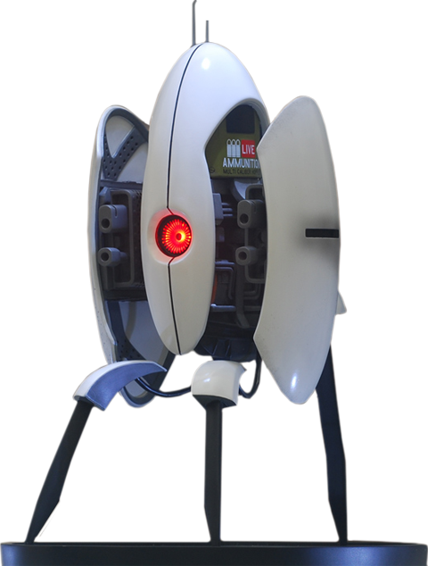
Deus Experis Machina
Our project focuses around AI recognition software used together with robotics
Project is split into three sections:
AI Recognition & Image Processing - Python
AWS Server (Publisher/Subscriber System) - C++
Embedded Hardware - C++

Slide 2
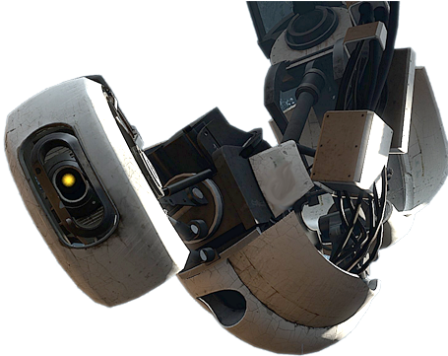
Remote AI
API interface created by image processing & recognition algorithms using modern AI models.
Using a wide variety of AI Detection models to detect, recognize and categorize objects into a dedicated API to be used via external hardware.
Specific features are:
Object detection (people/phones/dogs/cats etc)
Emotion detection (happiness/sadness etc)
Hand gestures (Finger positions/gestures etc)
And more!

Slide 3
Ron Shani
Education:
B.A
Chemistry and Biology - double major, Tel-Aviv University
B.Ed.
Science Teaching for high-graders, Levinsky College of Education 2020
Experience:
2020 - 2022
Head of robotics major and physics teacher
Peres High-school, Kiryat-ono
2015 - 2020
Product development manager
Tactics Education

Slide 4
Nisan Asraf
Education:
B.A
Physics - The Technion
Experience:
2020 - 2022
Assistant researcher - Solid state physics
The Technion - ICSI
2018 - 2020
Math & Physics High School Teacher for high-graders
Kiryat Bialik High School

Slide 5
Munther Farrah
Education:
B.Sc
Electrical & Electronics Engineering - Azrieli College of Engineering , Jerusalem.
Specialization : DSP (Digital Signal Processor), Embedded Systems.

Slide 6
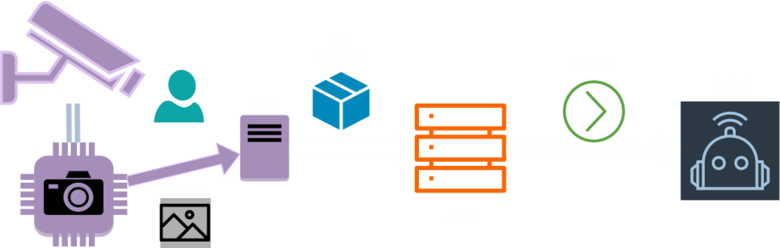
Goals
Using pretrained DNN models to visually detect objects & construct an API.
Entire process is described as:

Slide 7

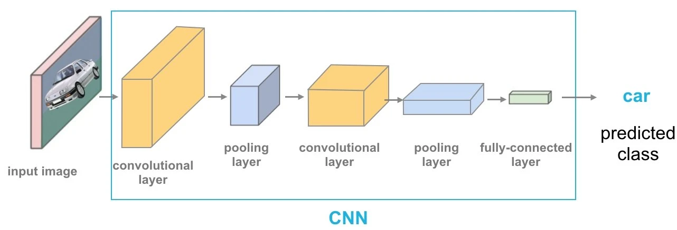
AI Detection & Recognition
Fundamental model:
OpenCV - Image analysis & recognition
Advanced models:
MediaPipe (Hand anchors detection)
DeepFace (Emotion detection)
YOLO (Object detection)

Slide 8
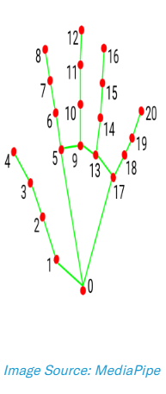
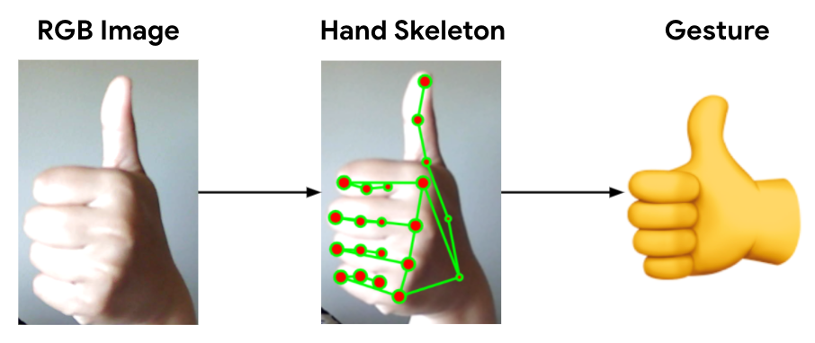
Hand Tracking Module
Using MediaPipe and OpenCV, we can anchor key points from the human hand to the image.
these points can then be used to identify coordinates in the frame.
by mapping each hand anchor we can create a versatile array of gesture configurations,
e.g, “thumbs up” can be mapped to anchors #4 > #3.

Slide 9
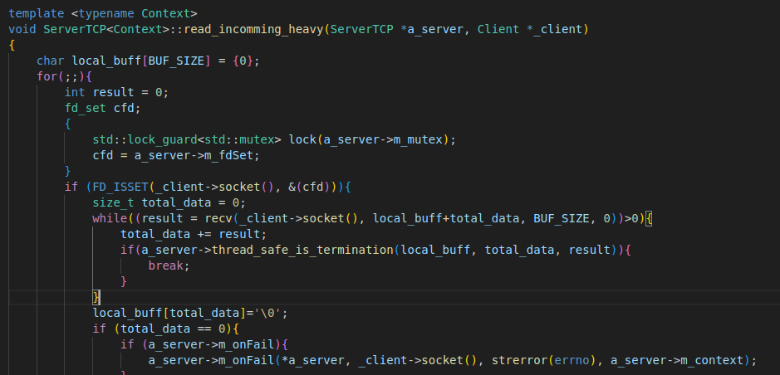
Server
AWS:
EC2 instance running TCP Server (plain C/C++)
Heavy clients get their own thread
Docker container

Slide 10
IoT Client
ESP32-S
One core → no threads, no delays
Four timers only (camera, ISR, I2C, brownout, wd, wifi…)
Heat disposal
std::vector<Functionality> actions = {
{Vehicle::go_forward, car},
{Vehicle::go_backward, car},
{Vehicle::turn_left, car},
{look_right, servo},
{look_left, servo},
{look_straight, servo}
};
rai_client.topic_loader(topics, actions);
class Functionality{
public:
Functionality();
~Functionality();
template <typename Function, typename... Args>
Functionality(Function a_func, Args&&... args);
void run();
private:
Task *m_function;
};
template <typename Function, typename... Args>
Functionality(Function a_func, Args&&... args);

Slide 11
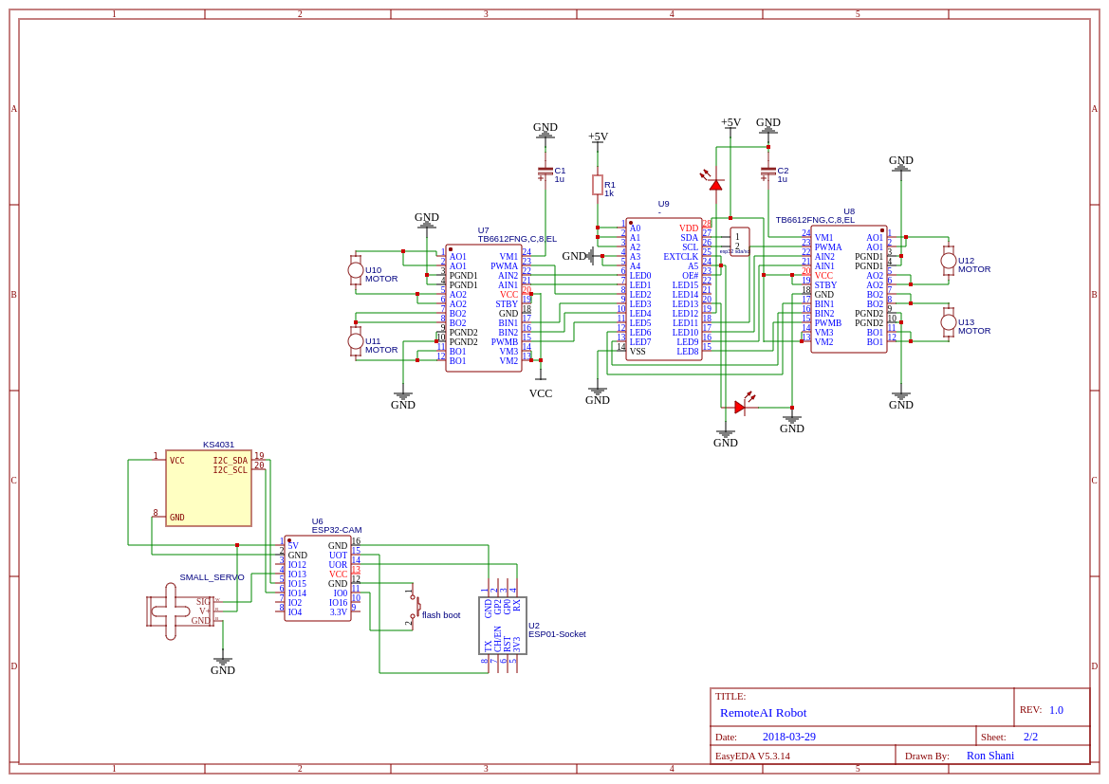
Robotics
Figuring out i2c address:
add = 0;
while add < i2c_addresses:
result =
si.i2c_start(add | I2C_WRITE)
++add
TwoWire I2C_Motors = TwoWire(bus 1)
TwoWire I2C_Camera = TwoWire(bus 0)
Wire.begin(SDA_2, SCL_2, freq)...

Slide 12
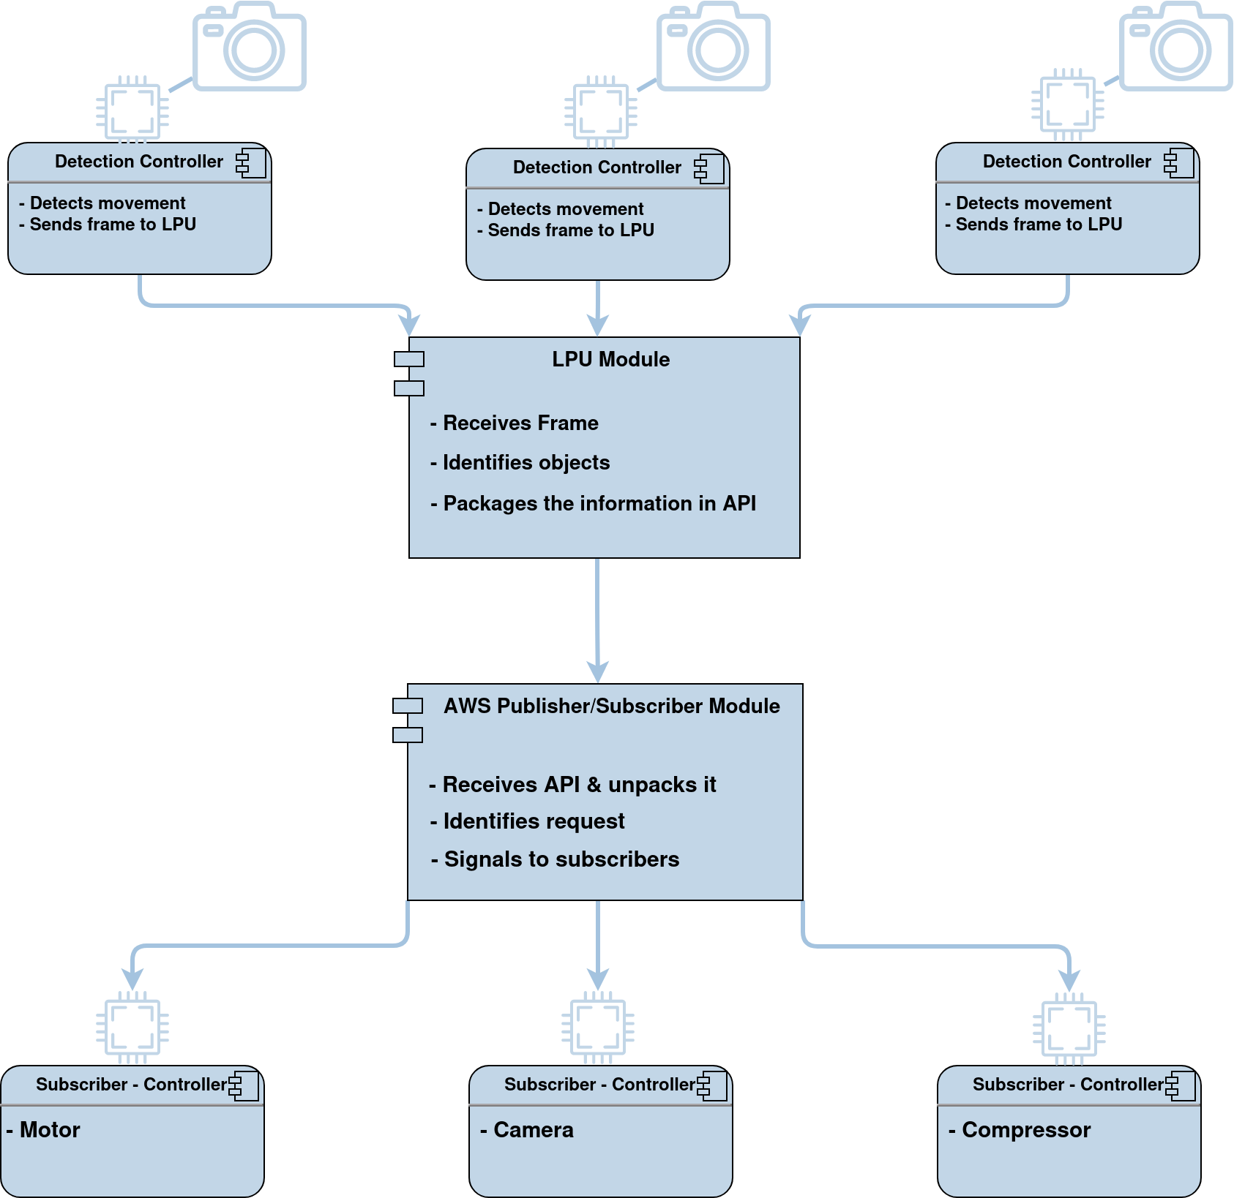

Slide 13
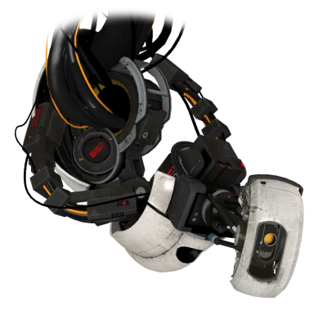
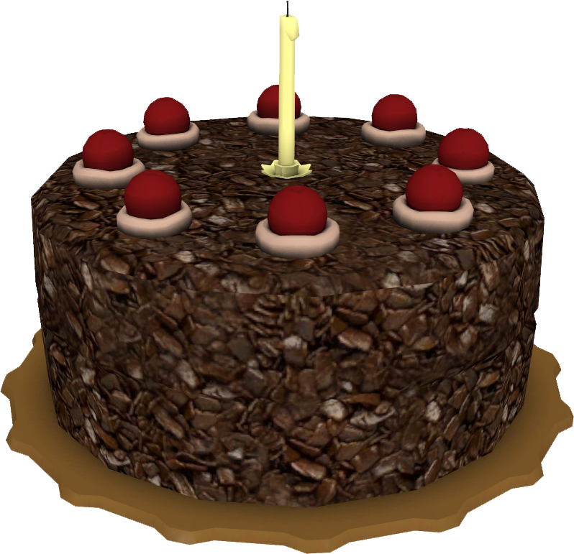
Questions.

